Slide 1
03BACKE25 – S01 Java Overview & Setup

Slide 2
AGENDA
Introduction to Java
The Java Ecosystem: JVM, JDK, JRE
Setting Up Your Environment
First Java Program: Hello, World!
Compilation vs. Interpretation
Variables and Constants
Comments in Java
Quiz Time!

Slide 3
Introduction to Java
A high-level, class-based, object-oriented programming language.
Known for its "Write Once, Run Anywhere" (WORA) principle.
Used for a wide range of applications: enterprise software, mobile apps (Android), web applications, and more.
Developed by Sun Microsystems (now Oracle).

Slide 4
The Java Ecosystem: JVM, JDK, JRE
JVM (Java Virtual Machine):
An abstract machine that enables a computer to run Java programs.
The "engine" that executes Java bytecode. It's the reason Java is platform-independent.
JRE (Java Runtime Environment):
Contains the JVM, core class libraries, and other supporting files.
Required to run a Java application. It's what end-users install on their machines.
JDK (Java Development Kit):
Includes the JRE, plus development tools like the compiler (javac), debugger, and archiver.
Required to develop a Java application. It's what programmers install.

Slide 5
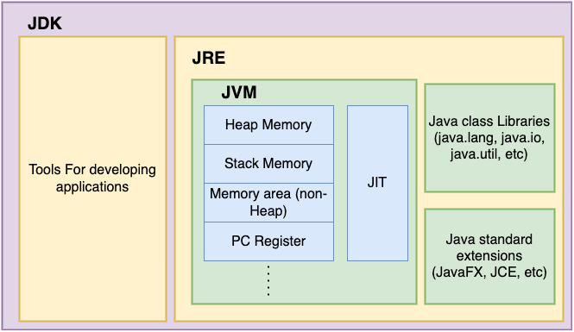
The Java Ecosystem: JVM, JDK, JRE

Slide 6
Setting Up Your Environment
Step 1: Install the JDK
Download the latest JDK from the official Oracle or OpenJDK website.
Follow the installation wizard for your operating system.
Step 2: Set up Environment Variables (PATH)
This allows you to run Java commands from any directory in your terminal or command prompt.
Add the bin directory of your JDK installation to your system's PATH variable.

Slide 7
Your First Java Program: Hello, World!
// MyFirstProgram.java
// Define a class named 'MyFirstProgram’
public class MyFirstProgram {
// The main method is the entry point of the program
public static void main(String[] args) {
// Use 'System.out.println' to print text to the console
System.out.println("Hello, World!");
}
}

Slide 8
Compilation vs. Interpretation
Compilation:
The entire program is converted to machine code before it is run.
Creates a platform-specific executable file (e.g., .exe).
Interpretation:
The program is translated and executed line by line at runtime.
No separate executable file is generated.
Java's Approach:
Java uses both.
Your Java source code (.java) is compiled into platform-independent bytecode (.class).
This bytecode is then interpreted by the JVM on any machine.

Slide 9
Variables and Constants
Variables:
A container for storing data values.
Syntax: dataType variableName = value;
Example: int age = 25;
The value can be changed. Example: age = 26;
Constants:
A variable whose value cannot be changed once assigned.
Use the final keyword.
Example: final double PI = 3.14159;
Convention is to use all uppercase for constant names.

Slide 10
Comments in Java
Comments are non-executable lines of code used to explain the program.
Single-line comment: // This is a single-line comment
Multi-line comment:
/*
* This is a multi-line comment
* It can span multiple lines
*/
Documentation comment:
/** * This is a documentation comment. * It is used by Javadoc to generate documentation. */

Slide 11
Quiz Time!
What is the primary function of the JVM?
To convert .java code into .class files.
B. To execute Java bytecode.
C. To manage the Java installation process.
D. To define variables and constants.

Slide 12
Quiz Time!
2. Which component is only needed if you are a developer writing Java code?
JRE
B. JVM
C. JDK
D. The compiler

Slide 13
Quiz Time!
3. What is the name of the file that contains the platform-independent bytecode?
MyFirstProgram.java
B. MyFirstProgram.exe
C. MyFirstProgram.class
D. MyFirstProgram.txt

Slide 14
Quiz Time!
Quiz Answers
1. B 2. C 3. C

Slide 15
THANK YOU

